Slide 1
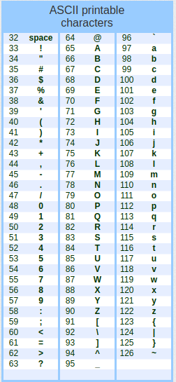
ASCII CODE
- ASCII code is an acronym for "American Standard Code for Information Interchange“.
It is a system used to represent text in computers .
It aims to provide a unified way to exchange information between different devices. ASCII is based on the use of 7 bits to represent 128 different symbols, including Latin letters, numbers, and some special symbols.
are some examples of codes in ASCII as shown in the image.
We notice the difference in the value of the capital and small of the same letter is 32, so from the side by which we can convert the letter from small to capital is by subtracting from its value 32

